Slide 1


CITS1003 Introduction to Cybersecurity [5] Vulnerabilities and Controls exercises
Dr Garrison Gao

Slide 2
DVWA (Damn Vulnerable Web Application)
Popular Web Attacks
SQLi (SQL injection)
Command Injection
XSS (Cross Site Scripting)
Unit Project

Slide 3
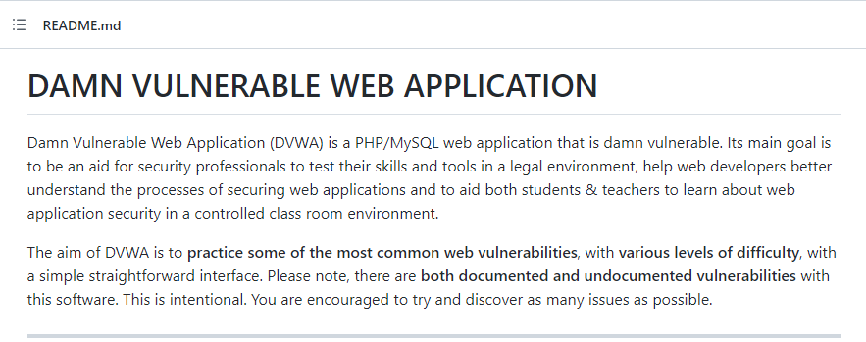
DVWA
https://github.com/digininja/DVWA

Slide 4
Deploying DVWA
Docker image is available:
https://hub.docker.com/r/vulnerables/web-dvwa
Run this image in your VM:
docker run --rm -it -p 80:80 vulnerables/web-dvwa

Slide 5
Deploying DVWA
Docker image is available:
https://hub.docker.com/r/vulnerables/web-dvwa
Run this image in your VM:
docker run --rm -it -p 80:80 vulnerables/web-dvwa
(access the DVWA web application from a web browser outside the container)
Open a browser in your VM:
Enter a URL: localhost/setup.php

Slide 6
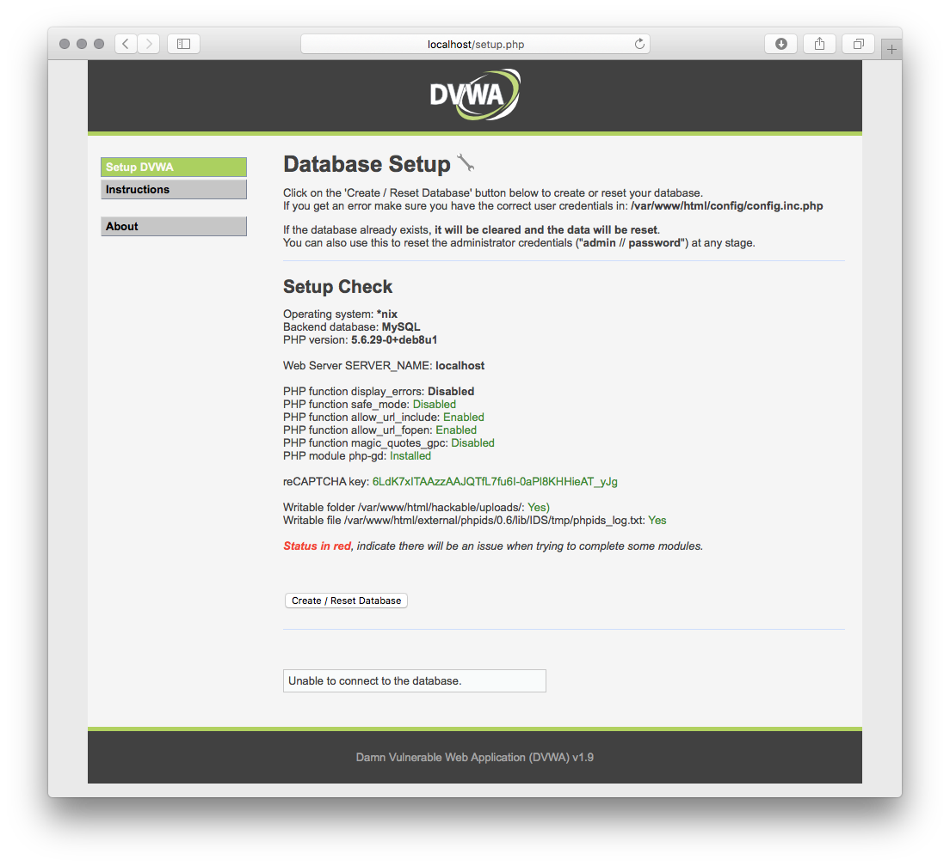

Slide 7
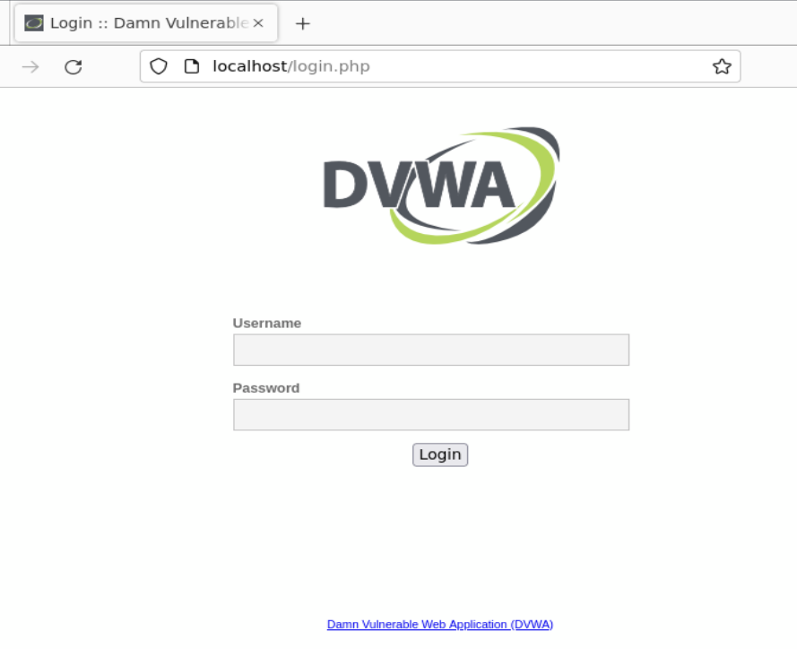
Login with default credentials.
Username: admin; Password: password

Slide 8
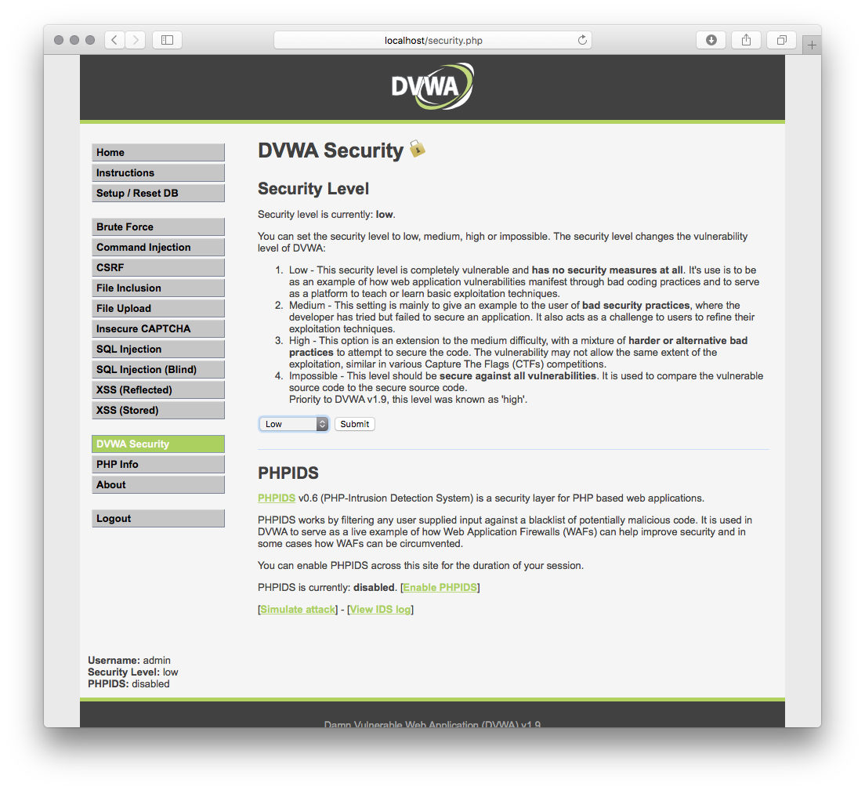
Set the security level to low

Slide 9
SQLi
What is SQLi?
SQL is Structured Query Language used to manage relational databases.
SQLi is an attack that targets security vulnerabilities in web applications that use SQL-based databases. SQLi allows an attacker to inject malicious SQL code into a vulnerable web application, which can break the CIA triad.

Slide 10
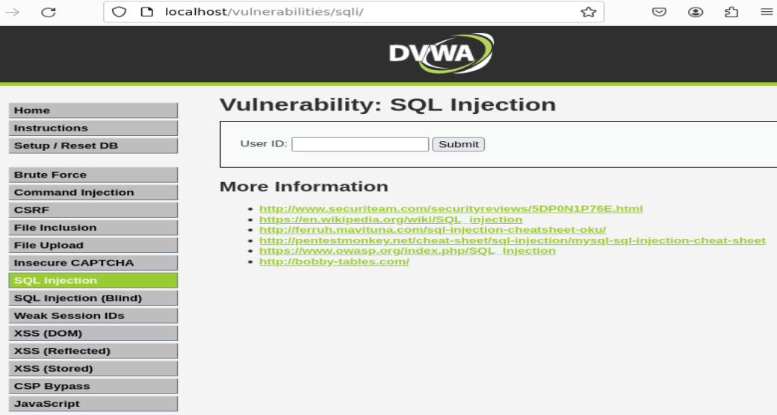
SQLi
How to run the demo

Slide 11
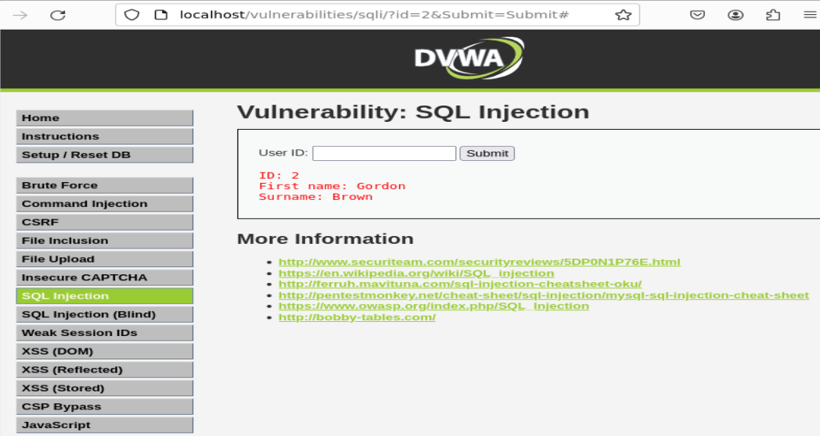
SQLi
How to run the demo
For the input box: 2

Slide 12
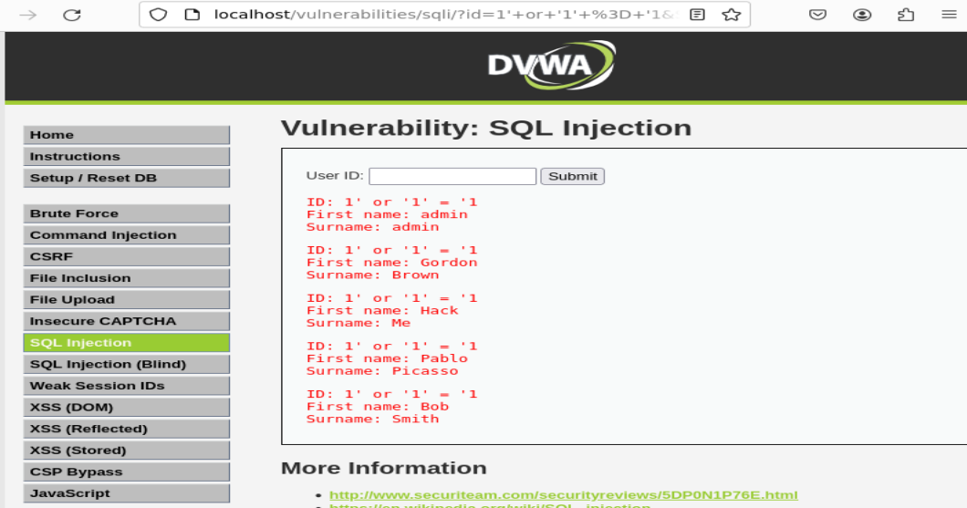
SQLi
How to run the demo
For the input box: 1’ or ‘1’ = ‘1

Slide 13
Command Injection
Demo

Slide 14
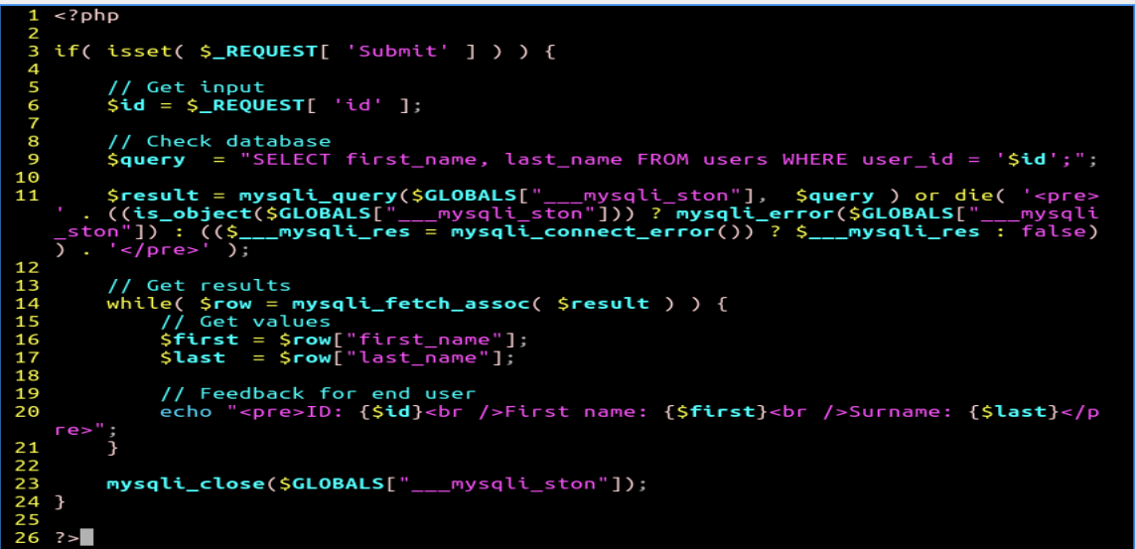
SQLi
How does SQLi occur?

Slide 15
SQLi
Line 3
First, it is an if statement:
1. if (condition) {
2. Code to be executed if condition is true.
3. }

Slide 16
SQLi
Line 3
First, it is an if statement:
1. if (condition) {
2. Code to be executed if condition is true.
3. }
e.g.,
1. $test = "30";
2. if ($test > "29") {
3. echo "hello world";
4. }

Slide 17
SQLi
Line 3
First, it is an if statement:
1. if (condition) {
2. Code to be executed if condition is true.
3. }
condition: isset():

Slide 18
SQLi
Line 3
isset($var): a function that checks whether the value of $var exists. If yes, it returns true, or false otherwise.
What is a function? A block of code that implements a specific task.

Slide 19
SQLi
Line 3
isset($var): a function that checks whether the value of $var exists. If yes, it returns true, or false otherwise.
What is a function? A block of code that implements a specific task.
e.g., function name($fname) { echo "$fname says: hello world"; } name(“Alice");

Slide 20
SQLi
Line 3
If isset returns true, then the condition for the if statement is true:
$_REQUEST is a variable. This variable is a special associative array that holds all HTTP request parameters from $_GET, $_POST, and $_COOKIE
Each entry is stored as a key–value pair:
The key is the parameter name (e.g. “Submit”, “id”).
The value is whatever the user passed in the request.

Slide 21
SQLi
Line 3
$_REQUEST[ ‘Submit’ ] is the value of the ‘Submit’ key.
What is the value of the ‘Submit’ key?

Slide 22
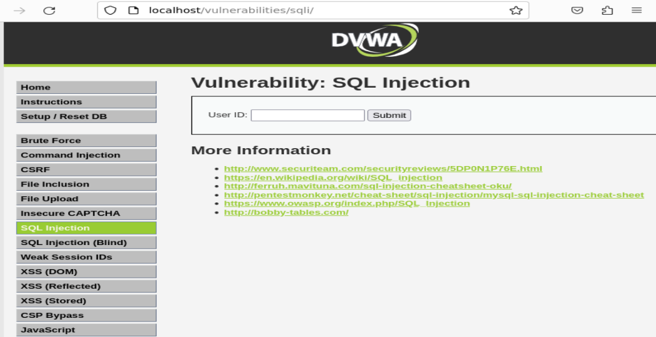
SQLi
$_REQUEST[ ‘Submit’ ] returns the value after clicking ‘Submit’

Slide 23
SQLi
$_REQUEST[ ‘Submit’ ] returns the value after clicking ‘Submit’ (e.g., Go, Send)
isset($_REQUEST[ ‘Submit’ ]) returns true if $_REQUEST[ ‘Submit’ ] is clicked
If (isset($_REQUEST[ ‘Submit’ ]) ) returns true if isset() returns true

Slide 24
SQLi
Line 6
$id: a variable
$_REQUEST[ ‘id’ ] returns the value of the ‘id’ key, which is the input from the ‘USER ID’
What does $id equal to? The value from $_REQUEST[ ‘id’ ]
e.g., if the input box is: 1, then $id equals to 1
if the input box is: 2, then $id equals to 2

Slide 25
SQLi
Line 9 is vulnerable
$query: a variable
SQL Statement: SELECT first_name, last_name FROM users WHERE user_id equals to ‘$id’;
SELECT, FROM and WHERE are SQL keywords:

Slide 26
SQLi
Line 9 is vulnerable
A ‘users’ table
e.g., SELECT first_name, last_name FROM users WHERE user_id = ‘1’;

Slide 27
SQLi
Line 9 is vulnerable
A ‘users’ table
e.g., SELECT first_name, last_name FROM users WHERE user_id = ‘1’;
first_name | last_name | user_id
‘Alice’ | ‘Admin’ | ‘1’
‘Bob’ | ‘Admin’ | ‘2’

Slide 28
SQLi
Line 9 is vulnerable
When $id equals to 1' or '1’=‘1
‘$id’ = ‘ 1’ or ‘1’=‘1 ’
user_id = ‘$id’
user_id = ‘1’ or ‘1’=‘1’

Slide 29
SQLi
Line 9 is vulnerable
Root cause of SQLi: ‘$id’ is an input and its value is not sanitized before it is used for this SELECT-based SQL statement.

Slide 30
SQLi
Line 9 is vulnerable
Root cause of SQLi: ‘$id’ is an input and its value is not sanitized before it is used for this SELECT-based SQL statement.

Slide 31
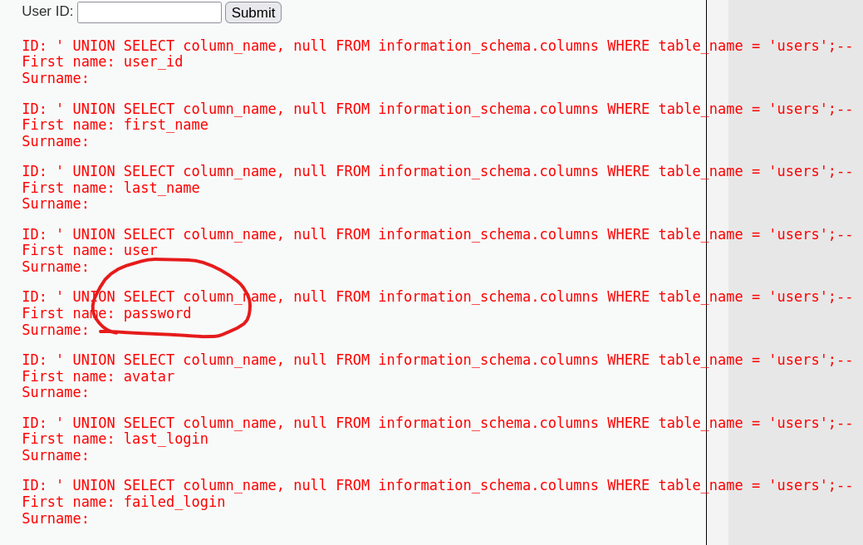
SQLi
Crack the password
Check all columns
a' UNION SELECT column_name, null FROM information_schema.columns WHERE table_name = 'users';-- -
information_schema.columns:
This is a system table (or view) provided by most relational databases (like MySQL, PostgreSQL, SQL Server).
It contains metadata (data about the database itself) for all columns of all tables.
https://www.w3schools.com/sql/sql_union.asp

Slide 32
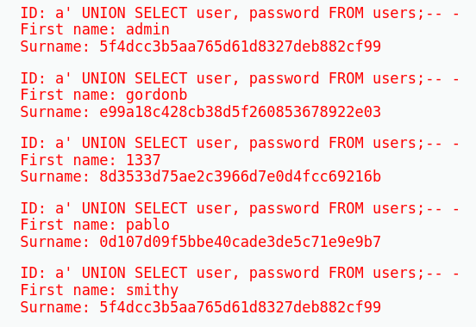
SQLi
Crack the password
Check all columns
a' UNION SELECT column_name, null FROM information_schema.columns WHERE table_name = 'users';-- -
Extract password
?id=a' UNION SELECT user, password FROM users;-- -
Break the hash value (the hash value is produced through MD5)
5f4dcc3b5aa765d61d8327deb882cf99
https://md5decrypt.net/en/

Slide 33
SQLi
How does SQLi occur?
How dangerous is SQLi?
How to mitigate SQLi?

Slide 34
SQLi
How does SQLi occur?
A malicious user injects some malicious SQL code into a web application.
The application implements a vulnerable logic that uses the code to interact with an SQL database.

Slide 35
SQLi
How does SQLi occur?

Slide 36
SQLi
How does SQLi occur?
How dangerous is SQLi?
e.g., data theft; unauthorized access (data modification).

Slide 37
SQLi
How does SQLi occur?
How dangerous is SQLi?
e.g., data theft; unauthorized access (data modification).
How to mitigate SQLi?

Slide 38
SQLi
How does SQLi occur?
How dangerous is SQLi?
e.g., data theft; unauthorized access (data modification).
How to mitigate SQLi?
e.g., input sanitisation

Slide 39
Command Injection
What is command injection?
It is an attack that allows a malicious user to inject crafted shell commands into vulnerable web applications. These commands are then executed by the applications to break the CIA triad.

Slide 40
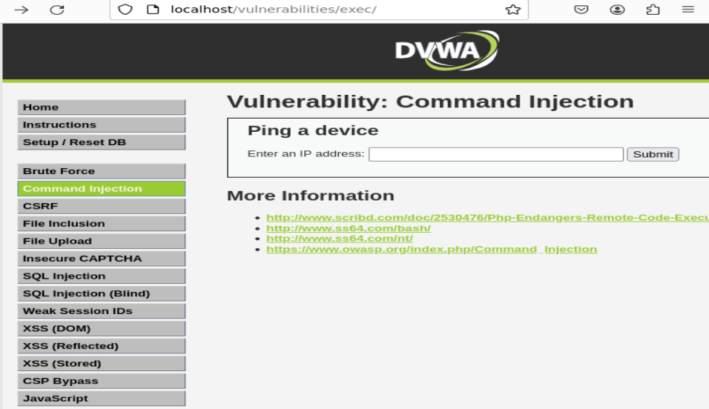
Command Injection
How to run the demo

Slide 41
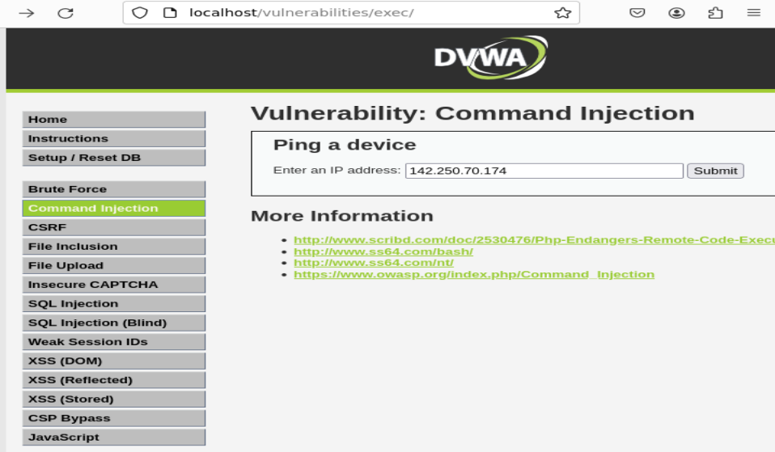
Command Injection
How to run the demo

Slide 42
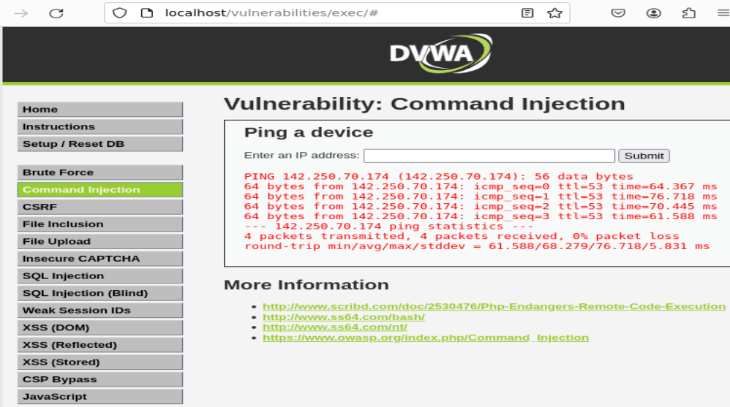
Command Injection
How to run the demo

Slide 43
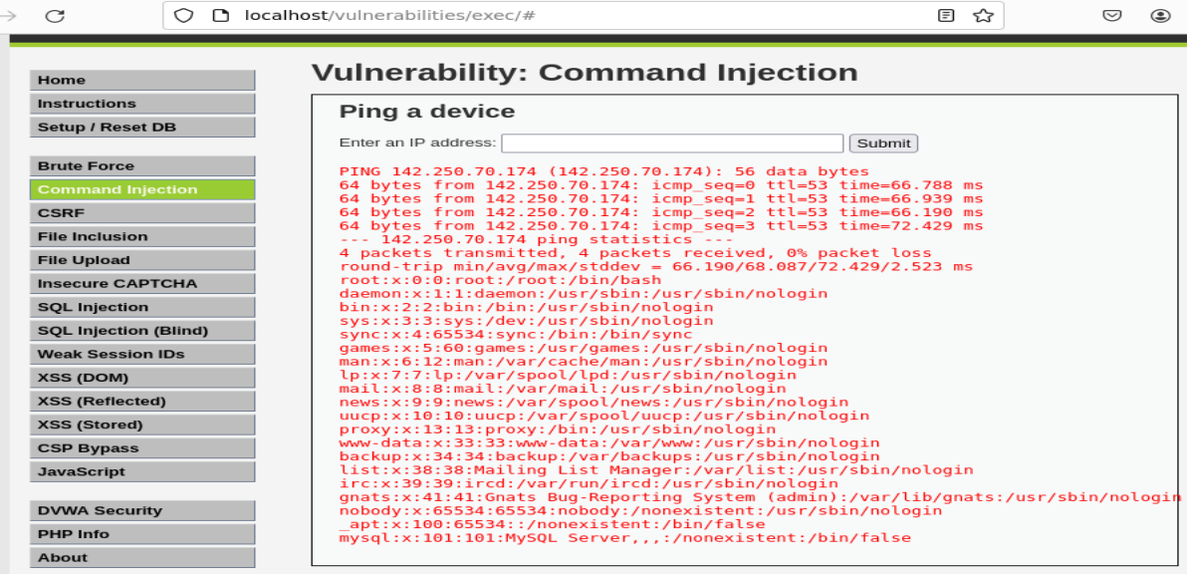
Command Injection
How to run the demo
For the input box: 142.250.70.174 ; cat /etc/passwd

Slide 44
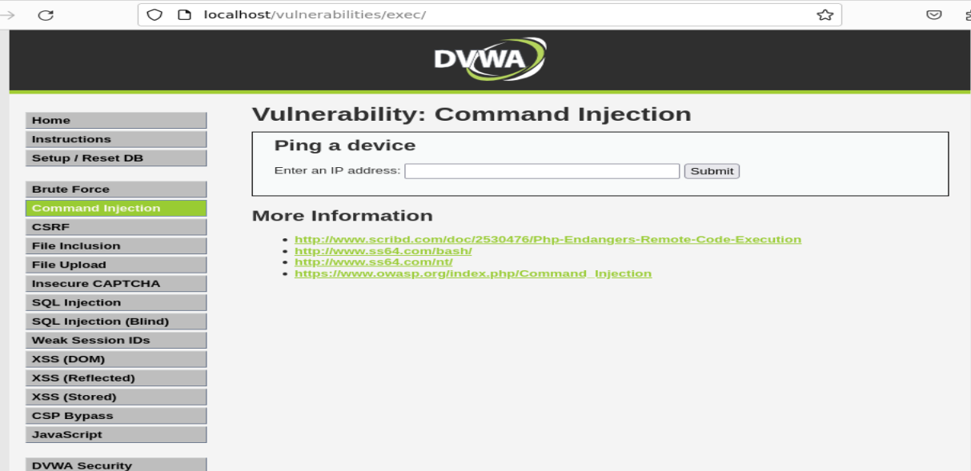
Command Injection
Demo

Slide 45
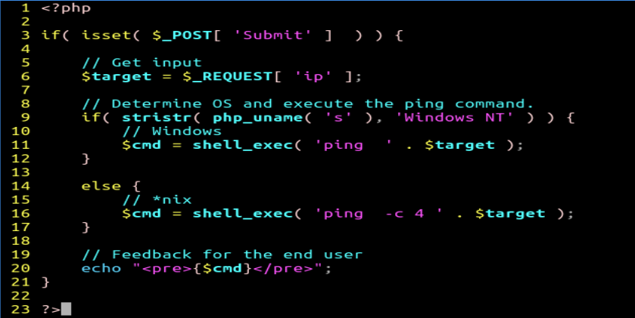
Command Injection
How does command injection occur?

Slide 46

Command Injection
Line 3
if (condition) is a statement; isset() is a function; $_POST is a variable; ‘Submit’ is a key

Slide 47
Command Injection
Line 3
1. $_POST [ ‘Submit‘ ] returns the value of the ‘Submit’ key;
2. if the returned value from step 1 exists, isset($_POST [ ‘Submit‘ ]) returns true, or false otherwise.
3. if the returned value from step 2 is true, for if ( isset($_POST [ ‘Submit‘ ]) ), the web application executes code inside its body.

Slide 48

Command Injection
Line 6
$target: a variable
$_REQUEST[ ‘ip’ ] returns the value of the ‘ip’ key, which is the input from the ‘Enter an IP address’ from the web page.

Slide 49
Command Injection
What does $target equal to? The value from $_REQUEST[ ‘ip’ ]
$_REQUEST[ ‘ip’ ] returns the value of the ‘ip’ key, which is the user input from the ‘Enter an IP address’ from the web page.

Slide 50

Command Injection
Line 16 is vulnerable
$cmd is a variable; shell_exec(command) is a function; ‘ping –c 4’ is a shell command; The dot (‘.’) is an operator; $target is a variable.

Slide 51
Command Injection
Line 16 is vulnerable
shell_exec(command) takes a command as a string input and returns an output generated by the command as a string.
‘.’ concatenates two strings together.

Slide 52
Command Injection
Line 16 is vulnerable
‘.’ concatenates two strings together.
When $target equals to ‘142.250.70.174 ; cat /etc/passwd’
The whole command for shell_exec becomes a string as below:
’ping –c 4 142.250.70.174 ; cat /etc/passwd’
The command will execute the ping as well as cat commands and its output will be assigned to $cmd.

Slide 53
Command Injection
Line 16 is vulnerable
Root cause of command injection: ‘$target’ is a variable and its value is decided by user inputs. The inputs are not sanitized before they are executed by the web application.

Slide 54
Command Injection
How does command injection occur?
How to prevent command injection?
How to detect command injection?

Slide 55
Command Injection
How does command injection occur?
A user injects some malicious shell commands into a web application.
The application implements a vulnerable logic that executes the commands.

Slide 56
Command Injection
How does command injection occur?

Slide 57
Command Injection
How does command injection occur?
How to prevent command injection?
e.g., input sanitisation
142.250.70.174 ; cat /etc/passwd

Slide 58
Command Injection
How does command injection occur?
How to prevent command injection?
e.g., input sanitisation
How to detect command injection?

Slide 59
Command Injection
How does command injection occur?
How to prevent command injection?
e.g., input sanitisation
How to detect command injection?
e.g., detecting unexpected outputs
ping –c 4 142.250.70.174 ; cat /etc/passwd

Slide 60
XSS
What is XSS?
XSS allows an attacker to inject malicious scripts into a vulnerable web application, tricking users into opening a phishing website.
XSS types: DOM XSS, Stored XSS, Reflected XSS

Slide 61
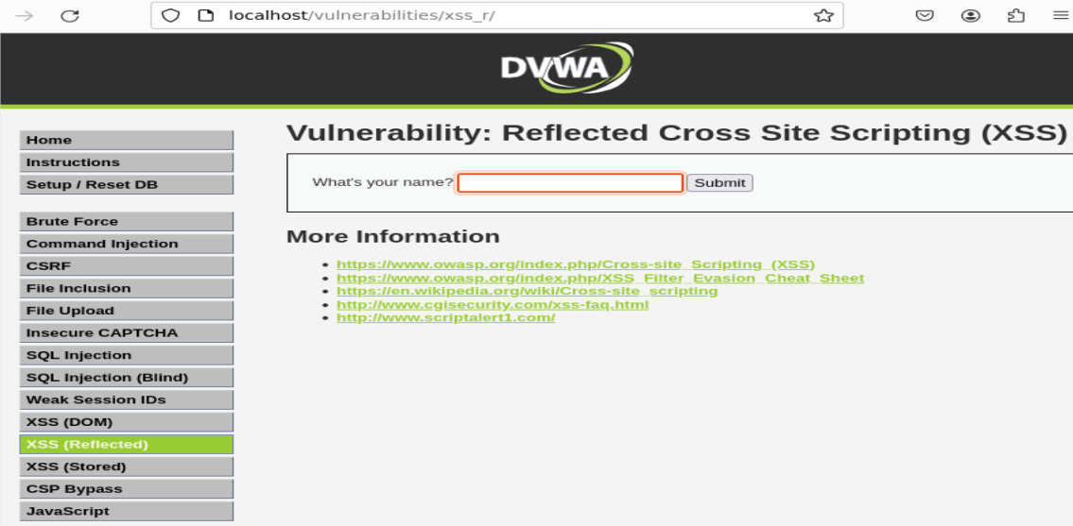
XSS
How to run the demo

Slide 62
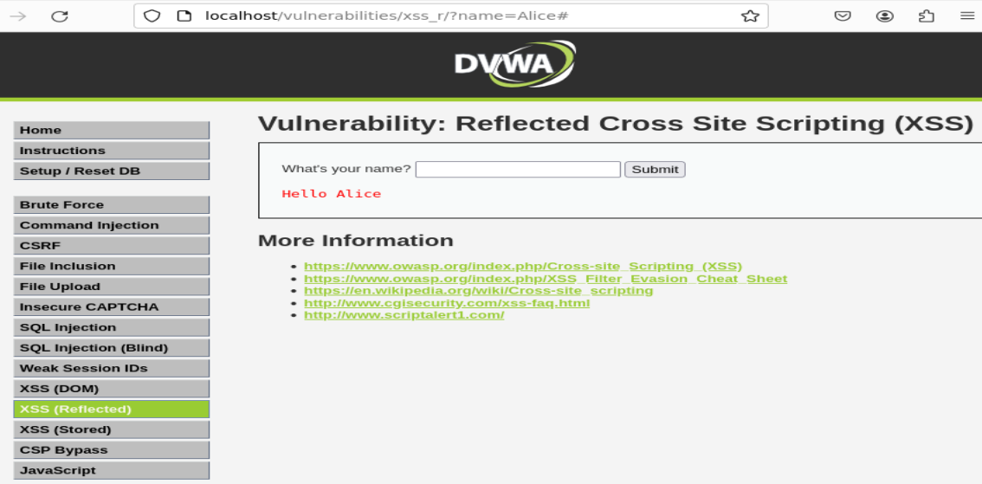
XSS
How to run the demo
For the input box: Alice

Slide 63

XSS
How to run the demo
For the input box: http://localhost/?name=<script> window.location = "https://uwa.edu.au"; </script>

Slide 64
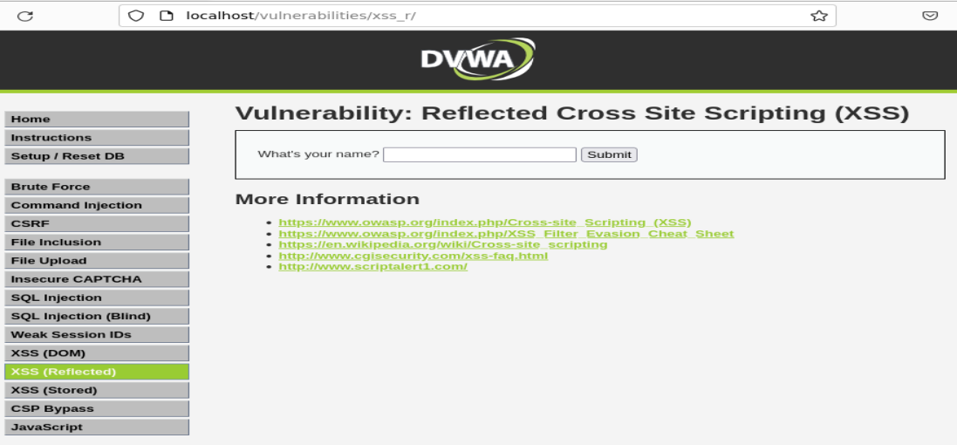
XSS
Demo

Slide 65
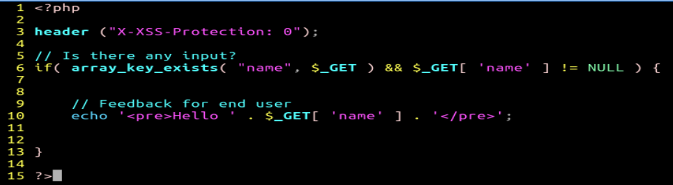
XSS
How does XSS occur?

Slide 66

XSS
Line 3
disabling the XSS protection built into modern browsers.

Slide 67
XSS
Line 6
if () is a statement; array_key_exists () is a function; $_GET is a variable; “name” or ‘name’ is a key; && is logical operator that means AND
Two conditions are concatenated via && for the if statement
array_key_exists(“name”, $_GET) is a condition
$_GET[ ‘name’ ] is the other condition

Slide 68
XSS
Line 6
array_key_exists(“name”, $_GET)
It checks whether the "name" key exists in the $_GET variable. If the key exists, this condition returns true;

Slide 69
XSS
Line 6
array_key_exists(“name”, $_GET)
It checks whether the "name" key exists in the $_GET variable. If the key exists, this condition returns true;
$_GET[ ‘name’ ]
It returns the value of the ‘name’ key. If the value is non-empty, this condition is true;
If both conditions are true, then code in line 10 will be executed.

Slide 70
XSS
Line 10 is vulnerable
echo is a command for printing; $_GET is a variable; ‘name’ is a key; The dot (‘.’) is an operator for concatenation.
<pre> and </pre> are HTML tags which are used to format the text between the tags. e.g.,
<pre>
Alice: Hello Bob!
Bob: Hello Alice!
</pre>

Slide 71
XSS
Line 10 is vulnerable
This echo statement will display hello and the value of the ‘name’ key back to the user’s browser.
When $_GET[ ‘name’] equals to:
http://localhost/?name=<script> window.location = "https://uwa.edu.au"; </script>
Code between the scripts will be executed by the browser.

Slide 72
XSS
Line 10 is vulnerable
Root cause of XSS: the value from the ‘name’ key is provided as an input and not sanitized before it is displayed back to the user.

Slide 73
XSS
How does reflected XSS occur?
How to mitigate reflected XSS?

Slide 74
XSS
How does reflected XSS occur?
An attacker crafts a URL with malicious script code included.
The user's browser is tricked into sending the crafted URL to the web application.
The application implements a vulnerable logic that displays the malicious input back to the user.
The user's browser receives the response and executes the script within the context of the vulnerable web application.

Slide 75
XSS
How does reflected XSS occur?

Slide 76
XSS
How does reflected XSS occur?
How to mitigate reflected XSS?
e.g., input sanitisation; security headers
http://localhost/?name=<script> window.location = "https://uwa.edu.au"; </script>

Slide 77
XSS
How does reflected XSS occur?
How to mitigate reflected XSS?
e.g., input sanitisation; security headers
disabling the XSS protection built into modern browsers.

Slide 78
Project
Availability
https://labs.cits1003.jinhong.org
Project Details
https://uwacyber.gitbook.io/cits1003/cits1003-project/overview

